Slide 1
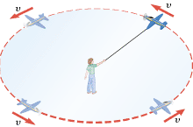
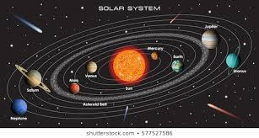
C H A P T E R 6
Dynamics of Uniform Circular Motion
Uniform circular motion is the motion of an object traveling at a constant (uniform) speed on a circular path.
Speed is constant, velocity is not.
Q. Do we need a force to keep an object on this circular path?
A. Yes. Centripetal Force
The tension in the guideline/rope is the centripetal force, which pulls the plane inward.

Slide 2
Centripetal Force
The centripetal force is the net force required to keep an object of mass m, moving at a speed v, on a circular path of radius r, and it has a magnitude of
Direction: The centripetal force always points toward the center of the circle and continually changes direction as the object moves.
Centripetal acceleration is:

Slide 3

Uniform Circular Motion Problem solving Receipe
Draw a free-body diagram.
Identify the unbalanced force, towards the center of the circle.
Set the unbalanced force equal to centripetal force.

Slide 4
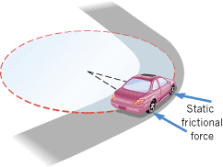
Car on a Flat-Curve
Question: What is the centripetal force for a car moving along a cul-de-sac?
Answer: Static frictional force between the road and the tires.
Problem: At what maximum speed can a car safely negotiate a horizontal unbanked turn (radius = 51 m) in dry weather (coefficient of static friction = 0.95)?

Slide 5
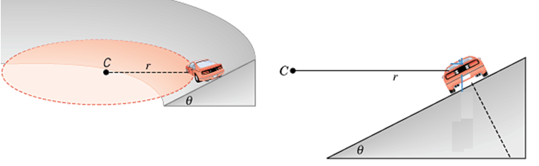
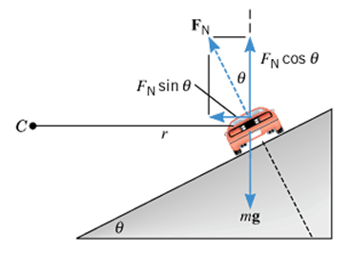
Banked Curves
Q: Why exit ramps in highways are banked?
A: To increase the centripetal force for higher exit speed.
26. What is the ideal speed to take a 100 m radius curve banked at a 20.0° angle?

Slide 6
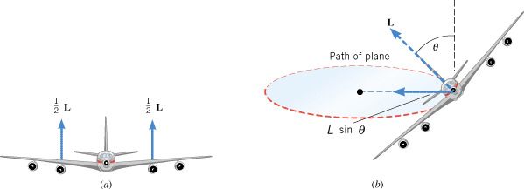
Question:
Why do airplanes make banked turn?
Answer:
To generate the centripetal force required for the circular motion.

Slide 7
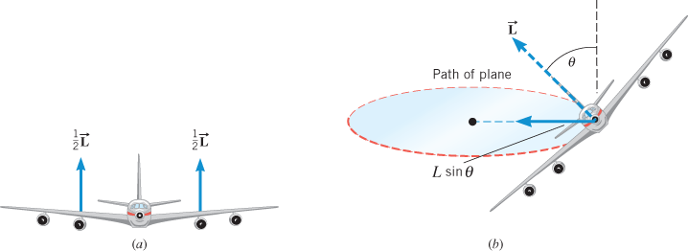
Problem
A jet flying at 123 m/s banks to make a horizontal circular turn. The radius of the turn is 3810 m, and the mass of the jet is 2.00 x 10^5 kg. Calculate the magnitude of the necessary lifting force.

Slide 8
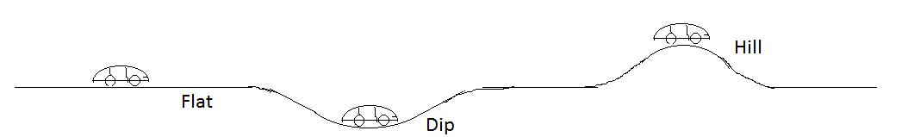
Changes in Normal Force as a Car moves along a Flat, Dip, and Hilly road

Slide 9
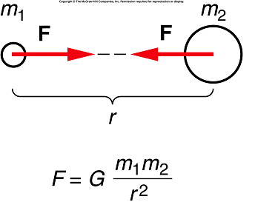
Newton’s Law of Universal Gravitation
Every body in the universe attracts every other body with a force that is directly proportional to the product of the masses of the bodies and inversely proportional to the square of the distance between the bodies.

Slide 10
Universal Gravitational Constant
The proportionality constant, G is called the universal gravitational constant. Its value in the SI system of units is,
G = 6.67 × 10⁻¹¹N.m²/Kg².
The law of gravitation is universal and very fundamental. It can be used to understand the motions of planets and moons, determine the surface gravity of planets, and the orbital motion of artificial satellites around the Earth.
Q: Force between 2 conversing people?
A: Very small due to very small value of G,….10⁻¹¹

Slide 11
Weight
Weight = Mass x Gravity
The weight of an object is the gravitational force that the planet exerts on the object. The weight always acts downward, toward the center of the planet.
SI Unit of Weight: : newton (N)

Slide 12
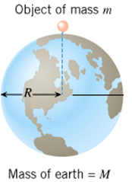
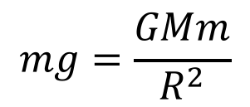

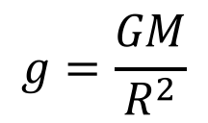
Acceleration Due to Gravity
Surface gravity for a planet can be calculated using the law of gravitation as follows:
Consider a mass m at the surface of a planet of Mass, M and radius, R.
Force of attraction between M and m is given by:
(It can be assumed that the whole mass of Earth is located as a point mass at the center, r = R)
$$F=\frac{GMm}{r^{2}}$$
This is also the weight, since weight is the force of gravity.
$$mg=\frac{GMm}{R^{2}}$$
$$g=\frac{GM}{R^{2}}$$
Cancelling m both sides yields g:

Slide 13
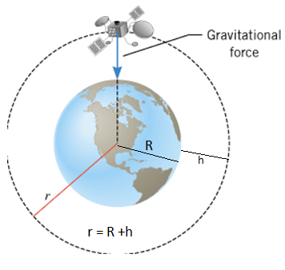
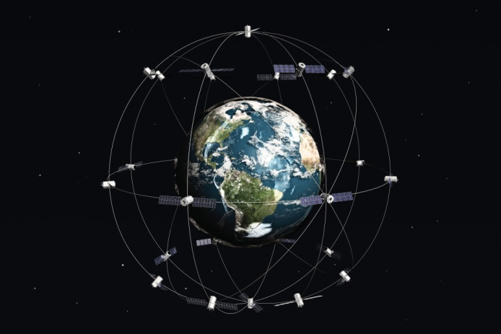

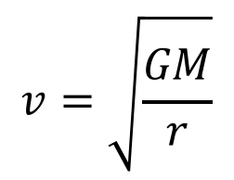
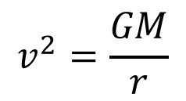
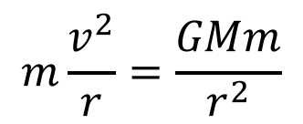
Satellites in Circular Orbits
Speed of the satellite, v can be obtained as follows:
$$m\frac{v^{2}}{r}=\frac{GMm}{r^{2}}$$
$$v^{2}=\frac{GM}{r}$$
Cancelling m and r both sides gives:
$$v=\sqrt{\frac{GM}{r}}$$
Determine the speed of the ISS, orbiting the Earth.
http://www.isstracker.com/

Slide 14
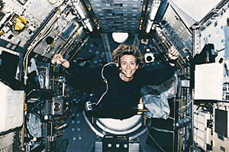
As she orbits the earth, this NASA astronaut floats around in a state of apparent weightlessness.

Slide 15
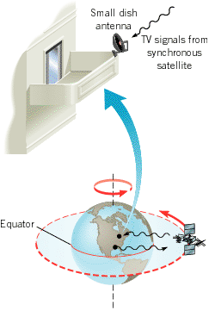
Synchronous Satellites
These satellites move around their orbits in a way that is synchronized with the rotation of the earth.
A synchronous satellite orbits the earth once per day on a circular path that lies in the plane of the equator.
Digital satellite system television uses such satellites as relay stations for TV signals.

